Slide 1
Software Architecture
Architectural Styles (Patterns)
Lecturer: Xiaobin Xu

Slide 2
Architectural design
An early stage of the system design process.
Architectural design
The design process for identifying the sub-systems making up a system and the framework for sub-system control and communication.
Software architecture is the output of architectural design process.

Slide 3
Definitions
An Architectural Style defines a set of rules that describe the properties of and constraints on its components and the way in which the components interact.
Architectural Style is a high level design Pattern
Design Pattern is a programming level design pattern
A set of architectural design solutions that have been used successfully before.
Mark of mature engineering field.
An architecture can use several architectural styles.
Styles are open-ended; new styles will emerge

Slide 4
Benefits
Promote reusability
Design reuse
Systems in the same domain often have similar architectures that reflect domain concepts.
Application product lines are built around a core architecture with variants that satisfy particular customer requirements.
Code reuse
Shared implementations of invariant aspects of style
Documentation reuse

Slide 5
Benefits
Improves development efficiency and productivity
Provide a starting point for additional and new design ideas.
Promotes communications among the designers
Phrase such as “client-server” conveys lot of information
quickly find a applicable SA design solution for a software system
make trade-offs and pre-evaluate the SA of system
diminish the risks of SA design
Notes:
reuse the knowledge, skills, experience and components in ever projects

Slide 6
Content of Software Architecture Pattern
Name
Each architecture pattern has a unique, short descriptive name.
Problem
Each architecture pattern contains a description of the problem to be solved. The problem statement may describe a class of problems or a specific problem.

Slide 7
The Content of Software Architecture Pattern
Context
The assumptions are conditions that must be satisfied in order for the architecture pattern to be usable in solving the problem. They include constraints on the solution and optional requirements that may make the solution more easy to use.
Models
The models is to describe the software architecture pattern.

Slide 8
The Content of Software Architecture Pattern
Consequences
The advantages and disadvantages of using this pattern.
Implementation
Additional implementation advice that can assist designers in customizing this architectural design pattern for the best results.
Known Uses
Known applications of the pattern within existing systems.

Slide 9
Architectural Styles (Patterns)
Pipe and Filter
The repository model (Shared Data Store)
Client-Server Style
One or two tier C/S
Three tier C/S
Model-View-Controller (MVC)
Layered Architecture
Peer-to-Peer Style
Event Driven Style

Slide 10
Architectural Styles:
Pipes and Filters

Slide 11
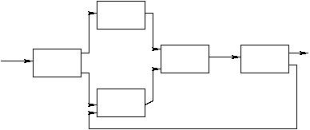
Pipes and Filters
A pipeline consists of a chain of processing elements, and the output of each element is the input of the next. Usually some amount of buffering is provided between consecutive elements.

Slide 12
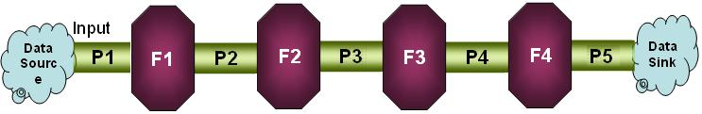
Pipes and Filters
Pattern Name: Pipe/Filter
Components: filters -- Data Handling Read a stream of data on its inputs and produce a stream of data on its outputs.
Connectors: pipes -- Data Translation and Transportation
Transmit output produced by filters to other filters.

Slide 13

Pipes and Filters
Topology: linear;
variations:feedback-loops, splitting pipes
Semantic Constraints
Filters are independent entities
they do not share state
they do not know their predecessor/successor

Slide 14

Pipe and Filter
Notes:
14
GetBurnRate runs continuously on its own, prompting the user for a new burn rate.
In this design the “compute new values” determines how much time has passed. Could alternatively do that in the GetBurnRate filter. Would change semantics a bit.

Slide 15
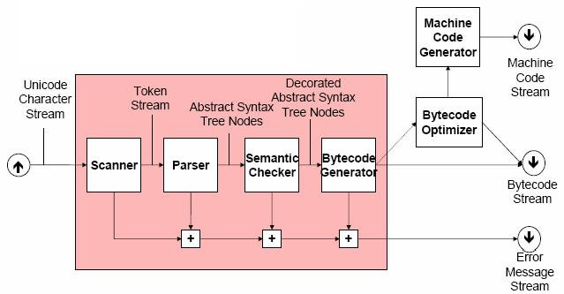
Pipes and Filters: Compiler

Slide 16
Invoice processing system

Slide 17
Advantages and Disadvantages of Pipe-Filter
Advantages:
High cohesive: Filters are self containing processing service that performs a specific function thus it is fairly cohesive
Low coupling: Filters communicate through pipes only, thus it is “somewhat” constrained in coupling
Reusability: Supports to reuse filters.
Simple to implement as either a concurrent or sequential system.
Notes:
both at design-time, run-time is difficult
Filters processes and sends streams of data over pipes is a solution that fits well with heavy batch processing, but may not do well with any kind of user-interaction.
Anything that requires quick and short error processing is still restricted to sending data through the pipes, possibly making it difficult to interactively react to error- events.
Advantages：
高内聚和低耦合
通过过滤器增加了灵活性。
过滤器组件的重用。
有利于系统的维护与更新－Evolution。
支持并行处理以提高效率。
Disadvantages：
增量式处理数据时，存在效率问题。
数据格式问题：数据转换额外开销。
不适合交互式应用系统

Slide 18
Advantages and Disadvantages of Pipe-Filter
Extendibility: easy to add new filters.
Flexibility:
functionality of filters can be easily redefined
control can be re-routed
Disadvantages:
requires a common format for data transfer along the pipeline.
difficult to support event-based interaction

Slide 19
Architectural Styles:
The Repository Model

Slide 20
The Repository Model
Sub-systems must exchange data. This may be done in two ways:
Shared data is held in a central database or repository and may be accessed by all sub-systems;
Each sub-system maintains its own database and passes data explicitly to other sub-systems.
When large amounts of data are to be shared, the repository model of sharing is most commonly used.

Slide 21
CASE toolset architecture

Slide 22
The Repository Model
Two variations:
Blackboard style: the data-store alerts the participating parties whenever there is a data-store change (trigger)
Repository style: the participating parties check the data-store for changes

Slide 23
The Repository Model
Problem domains that fit this style such as patient processing, tax processing system, inventory control system; etc. have the following properties:
All the functionalities work off a single data-store.
Any change to the data-store may affect all or some of the functions
All the functionalities need the information from the data-store

Slide 24
Blackboard Style
Two kinds of components
Central data structure — blackboard
Components operating on the blackboard
System control is entirely driven by the blackboard state
Applicability:
Typically used for AI systems
24
Notes:
24

Slide 25
Blackboard Style: DB triggers
a database management trigger has 3 parts:
Event : change to the database that alerts or activates the trigger
Condition: a test that is true when the trigger is activated
Action: a procedure which is executed when the trigger is activated and the condition is true.
Notes:
1) A trigger may be thought as a monitor of the database for changes to the
database that matches the event specification (e.g. deletion of bank cust. record)
2) Then the condition is checked to see if it is true (e.g. deleted cust record has
negative bank accnt amount).
3) If the delete record has a negative accnt amount, then kick off a procedure to
send error message out and delay the execution of cust record deletion.

Slide 26
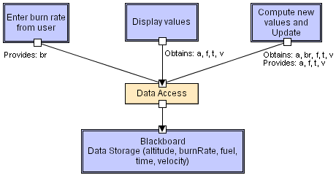
Blackboard

Slide 27
Repository model
Advantages:
The independent functions are cohesive within itself and the coupling is restricted to the shared data
Single data-store makes the maintenance of data in terms of back-up recovery and security easier to manage
Efficient way to share large amounts of data.
Notes:
Sub-systems need not be concerned with how data is produced Centralised management e.g. backup, security, etc.

Slide 28
Repository model
Disadvantages:
Difficult to manage data
Any data format change in the shared data requires agreement and, potentially, changes in all or some the functional areas - - this becomes a bigger problem as more functionalities are introduced that have dependency on the shared data.

Slide 29
Repository model
Data evolution is difficult and expensive;
If the data-store fails, all parties are affected and possibly all functions have to stop
redundant db
good back up- and recovery procedures

Slide 30
Architectural Styles:
Client-server Style

Slide 31
Client-server Style
Components are clients and servers
Client: an application that makes requests (to the servers) and handles input/output with the system environment
Server: an application that responses requests from clients.
Servers do not know number or identities of clients
Clients know server’s identity
Notes:
specific services such as printing, data management, etc.
Connectors are RPC-based network interaction protocols

Slide 32
Client-server Style
Connectors are RPC-based network interaction protocols
Why Client / Server?
multiple users want to share and exchange data
Typical application area:
distributed multi-user (business) information systems

Slide 33
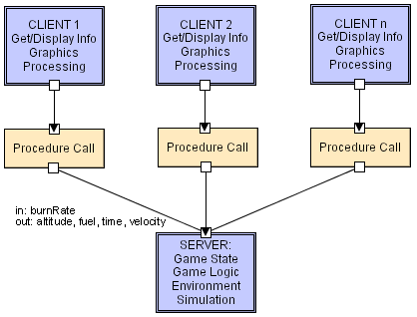
Client-Server Style

Slide 34
Film and picture library

Slide 35
Client/Server Characteristics
Dependencies: client depends on the server
Topology:
one or more clients may be connected to a server.
there are no connections between clients
Synchronicity: synchronous or asynchronous
Mobility: easily supports client mobiliy
Security: typically controlled at server, also possible at application/business layer

Slide 36
One or Two Tier Client/Server Architectures
Processing management split between user system interface environment and database management server environment.
Tier 1: user system interface: In user's desktop environment
Tier 2: database management services: In a server
Limitations
Performance deteriorate when number of clients is large.

Slide 37
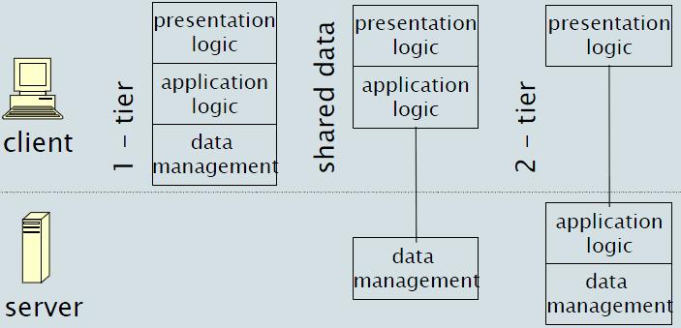
One or Two Tier Client/Server Architectures

Slide 38
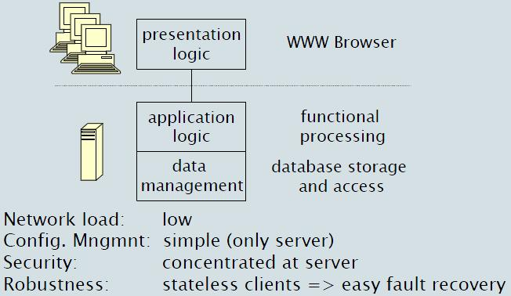
C/S Example: Thin Client
largest part of processing at the server-side

Slide 39
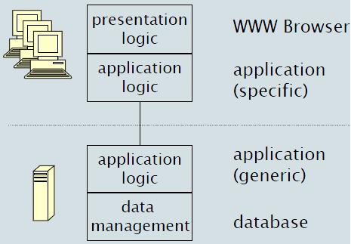
C/S Example: Thick Client
Thick Client: significant processing at the client-side

Slide 40
C/S Example: Thick Client
Network load: high
Config. Mngmnt: complex (both client & server)
Security: complex (both client & server)
Robustness: clients have state => complex fault recovery

Slide 41
Client-server characteristics
Advantages
Makes effective use of networked systems. May require cheaper hardware;
Easy to add new servers or upgrade existing servers.
Allows sharing of data between multiple users
Scalable: add new client

Slide 42
Client-server characteristics
Disadvantages
Redundant management in each server;
Hard to find out what servers and services are available. No central register of names and services
Difficult to change functionalities of server and client
Changing application logic is difficult if it is distributed over C&S
Scalability of applications is limited by server & network capacity

Slide 43
Three Tier Client/Server Architecture
3 Tier architecture:
Presentation Layer Presentation Layer is the layer responsible for displaying user interface.
Business Tier Business Tier is the layer responsible for accessing the data tier to retrieve, modify and delete data to and from the data tier and send the results to the presentation tier. This layer is also responsible for processing the data retrieved and sent to the presentation layer.

Slide 44
Three Tier Client/Server Architecture
BLL and DAL Often this layer is divided into two sub layers: the Business Logic Layer (BLL), and the Data Access Layers (DAL). Business Logic Layers are above Data Access Layers, meaning BLL uses DAL classes and objects. DAL is responsible for accessing data and forwarding it to BLL.
Data Tier Data tier is the database or the source of the data itself.

Slide 45
Three Tier Client/Server Architecture
presentation logic ([G]UI):
anything that involves system/user interaction e.g. dialogs (management), forms, reports
application logic (data processing):
where the functionality of the application resides / where the actual computation of the system takes place
data management:
storing, retrieving and updating data

Slide 46
Three Tier Client/Server Architecture
Common mistakes
tightly coupling layers in technology
writing business logic in presentation tier

Slide 47
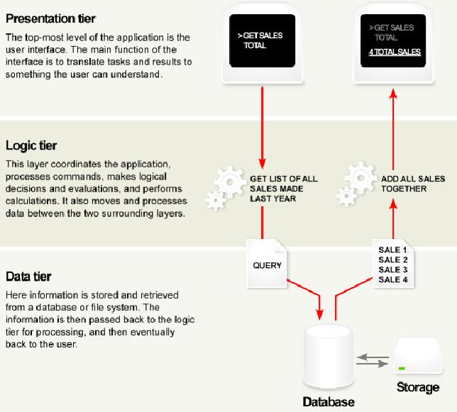
3-tier System

Slide 48
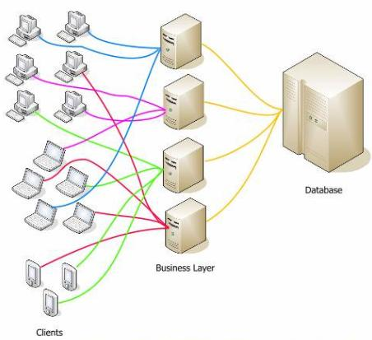
Deployment: Many physical clients and servers

Slide 49
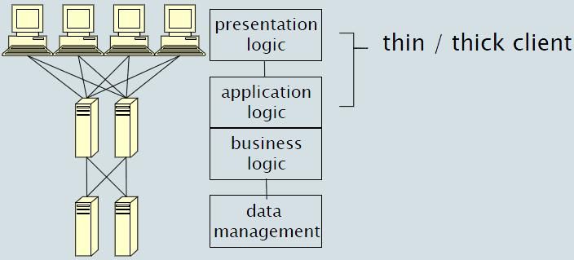
3-tier C/S Implementation Scenarios

Slide 50
Three Tier Client/Server Architecture
Advantages comparing with two tier CS style:
Better performance.
Better scalability, reusability and maintainability.
Security measures can be centrally allocated.
Parallel development of different layers

Slide 51
Architectural Styles:
Model View Controller

Slide 52
Model View Controller
The Model-View-Controller (MVC) pattern separates the modeling of the domain, the presentation, and the actions based on user input into three separate classes
The controller changes the model
The View Listens to Model Changed events and update itself

Slide 53
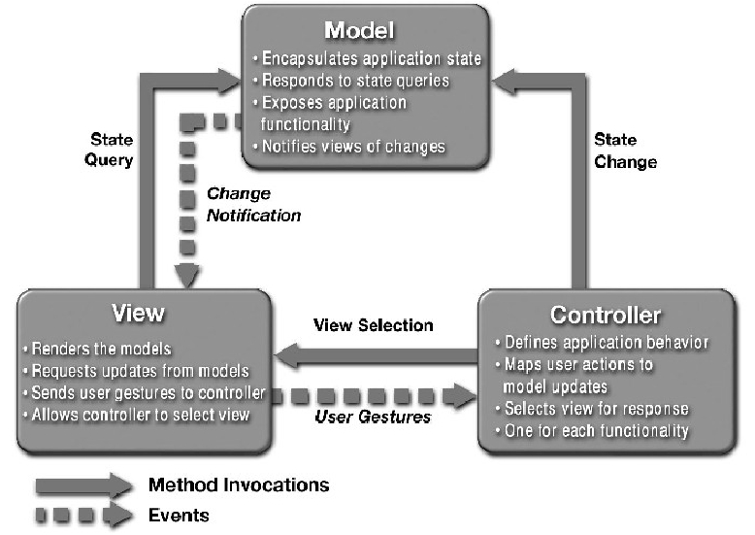
MVC Pattern

Slide 54
Advantages and Disadvantages
Advantages:
Views, controller, and model are separate components that allow modification and change in each “layer” without significantly disturbing the other
The view component, which often needs changes (UI technology improvement) and updates to keep the users continued interests, is separate

Slide 55
Advantages and Disadvantages
The View-Controller can keep on partially functioning even if the model component is down.
Disadvantages:
Heavily dependent on the development and production system environment and tools that match the MVC architecture (e.g. TomCat, .Net, Rail, etc.)

Slide 56
Architectural Styles:
Layered System

Slide 57
Layered System
Pattern Name: Layered System
Component: Layer
Connector: Interaction Protocol between layers

Slide 58
Layered architecture
The high level design solution is decomposed into Layers:
Structurally, each layer provides a related set of services
Dynamically, each layer may only use the layers below it
Screen
Presentation layer
1. If any layer only uses the layer directly below it, then it is a Strict Layered Style.
2. If a layer may use any of the layers below it, then it is a Relaxed Layer Style
Logic layer
File layer
Notes:
Using and evoking is not necessarily the same
(subtle difference))
Layer A may use layer B because it depends on something B does (e.g. data written to a db by B to be used by A), but never call upon it.
Layer A evokes layer B says Layer A passes control or data or both directly to B.

Slide 59
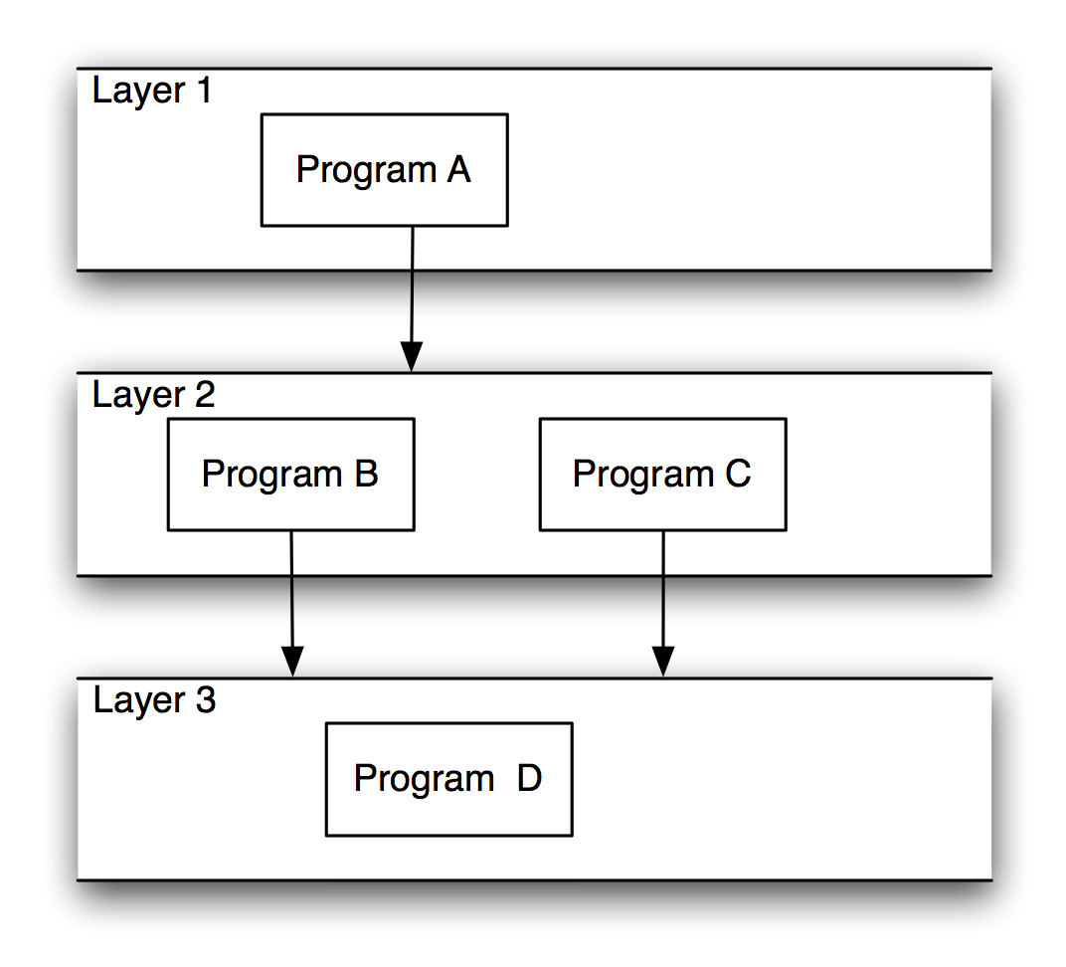
Layered Systems/Virtual Machines
Notes:
Implementation
根据抽象准则定义抽象层次
每个抽象层次对应模式中的一层。
是否把某些功能分在两个层次/或者合并成一个层次时需要权衡利弊
过多的层次增加开销。
层次太少则结构比较差。
给每个层次命名并指定任务
最高层的任务是整个系统的任务。如果较高层完成某个任务的时候，需要使用到下一个抽象层次的细节，那么给下一层次增加相应的任务。
分层的时候还需要考虑到将来的重用。设计底层时需要考虑可能的标准以增加重用的特性。

Slide 60
Layered Style
Hierarchical system organization
“Multi-level client-server”
Each layer exposes an interface (API) to be used by above layers
Each layer acts as a
Server: service provider to layers “above”
Client: service consumer of layer(s) “below”
Connectors are protocols of layer interaction
Example: operating systems
Notes:
60

Slide 61
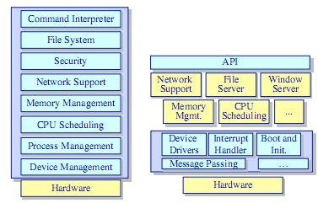
Example 1
Monolithic OS& Micro-kernel OS

Slide 62
Example 2
It is quite common for enterprise application architects to compose their solutions into the following three layers:
Presentation. This layer is responsible for interacting with the user.
Business. This layer implements the business logic of the solution.
Data. This layer encapsulates the code that accesses the persistent data stores such as a relational database.

Slide 63
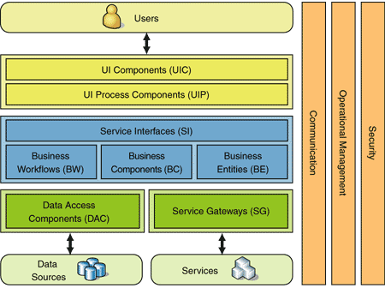

Slide 64
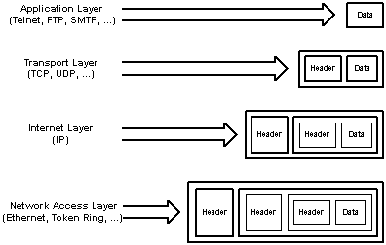
Example 3
The Tcp/IP protocol also is a layered system.

Slide 65
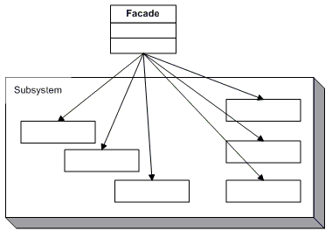
Layered System
Notes:
为每个层次指定服务接口
一般来说，第J层应该对于第J+1层是黑盒。
可以考虑设计一个flat接口，并且把这个接口封装在一个facade对象中。
灰盒：上层能够知道下层由哪些组件组合而成，但是不知道每个组件的内部结构。
应该尽量使用黑盒的方式，除非有一些特殊的原因：比如效率牵涉到系统的成败。
使用标准的接口将使得程序的适应性增强。

Slide 66
Version management system

Slide 67
Advantages and Disadvantages
Advantages:
Each layer is selected to be a set of related services; thus the architecture provides high degree of cohesion within the layer.
Each layer may hide private information from other layers
Layers may use only lower layers, constraining the amount of coupling.
Easy to add and/or modify a current layer
Notes:
指定相邻层之间的交互模式
Push model
Pull model
指定服务
在层次之间分配他们需要对上层提供的具体服务。
一般来说：把比较多的服务放在较高层次，而在底层提供的服务应该少，灵活，全面。
设计一种错误处理策略
对于层式体系结构，错误处理在处理时间和编程工作方面的代价比较大。
当错误发生的时候，程序既可以直接处理，也可以把他们发送到更高层次处理。发送到更高层次时，需要使用高层能够理解的错误描述。
应当尽可能在低层处理错误。
至少应该设法将错误归类，避免高层要直接面对众多的难以理解的错误代码。

Slide 68
Advantages and Disadvantages
Changes in a layer affect at most the adjacent two layers
Each layer, being cohesive and is coupled only to lower layers, makes it easier for reuse by others and easier to be replaced or interchanged
change of DB touches only the data store/access layer, change of browser only changes the presentation layer.

Slide 69
Advantages and Disadvantages
Different implementations of layer are allowed as long as interface is preserved
Supports the incremental development of sub-systems in different layers.
Supports design by abstraction levels.
Disadvantages:
Strict Layered Style may cause performance problem depending on the number of layers
Not always easy to structure in clean layers.
Notes:
System performance may suffer from unnecessary layering overhead (function calls)
Consequence
Advantage：
层的重用
标准化的支持
局部依赖特性
可替换性
Disadvantage：
更改行为的重
当对低层的修改由于某种原因影响了高层的时候，对低层的局部修改必须在多个层次上进行。
降低了效率
上层到下层之间需要进行层层的参数传递/转换等。
Debugging in Strict Layered Style may be complex

Slide 70
Architectural Styles:
Peer-to-Peer Style

Slide 71
Peer-to-Peer Style
No distinction between processes (nodes). Each process (node) can act as both a server and a client.
Peers: Each maintain its own data-store, as well as a dynamic routing table of addresses of other nodes
Connectors: Network protocols, often custom.
Notes:
Topology: Network (may have redundant connections between peers); can vary arbitrarily and dynamically
Supports decentralized computing with flow of control and resources distributed among peers. Highly robust in the face of failure of any given node. Scalable in terms of access to resources and computing power. But caution on the protocol!

Slide 72
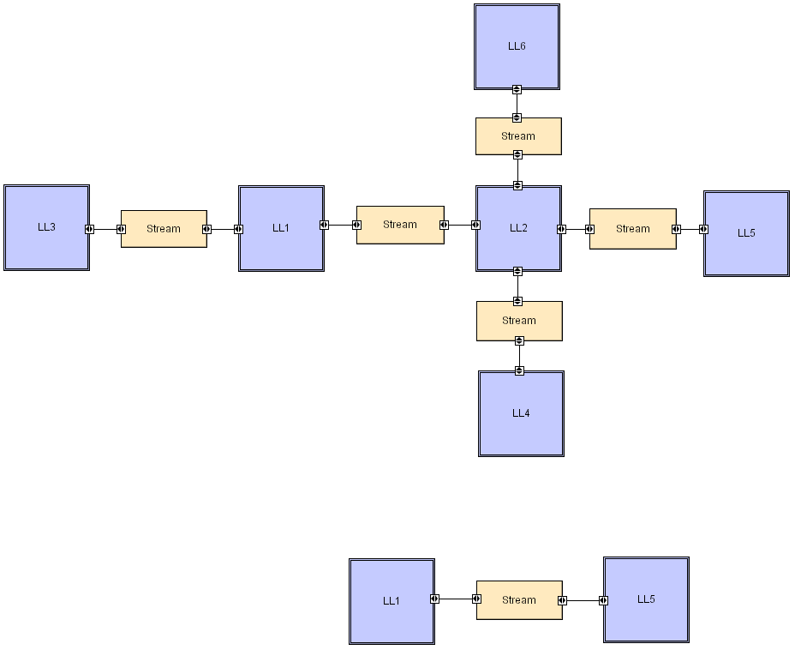
Peer-to-Peer

Slide 73
Architectural Styles:
Event-Driven Style

Slide 74
Event-Driven Style
The high level design solution is based on an event dispatcher which manages events and the functionalities which depends on those events. These have the following characteristics:
Events may be a simple notification or may include associated data
Events may be prioritized based on constraints such as time
Events may require synchronous or asynchronous processing
Events may be “registered” or “unregistered” by components
Notes:
Some components announce (broadcast) events
Other components register interest in events
Associate a routine to each event, automatically executed when the event is produced.
A part of the system is in charge of transmitting events between producers and consumers.
Semantic constraints
Announcers of events don't know which components are affected
No assumption about order of processing

Slide 75
Event-Driven Style
Problems that fit this architecture includes real-time systems such as: airplane control; medical equipment monitor; home monitor; embedded device controller; game; etc.

Slide 76
Event-Driven Style
Two principal event-driven models
Broadcast models.
An event is broadcast to all sub-systems. Any sub-system which can handle the event may do so;
Interrupt-driven models.
Used in real-time systems where interrupts are detected by an interrupt handler and passed to some other component for processing.

Slide 77
Broadcast model
Sub-systems register an interest in specific events. When these occur, control is transferred to the sub-system which can handle the event.
Control policy is not embedded in the event and message handler. Sub-systems decide on events of interest to them.

Slide 78
Selective broadcasting

Slide 79
Interrupt-driven control
Notes:
Used in real-time systems where fast response to an event is essential.
There are known interrupt types with a handler defined for each type.
Each type is associated with a memory location and a hardware switch causes transfer to its handler.
Allows fast response but complex to program and difficult to validate.

Slide 80
Advantages and Disadvantages
Advantages:
The event sensors and the event processors are separate, providing decoupled and individual functionalities.
The replacement and additions are independent and thus easier to perform
Any sensor or processing malfunction will not affect the other sensors and processors
High reuse potential

Slide 81
Advantages and Disadvantages
Disadvantages:
It is difficult for the dispatcher to react to a myriad of sensor inputs and respond in time (especially on simultaneous inputs)
A dispatcher malfunction will bring the whole system down.
Dispatcher is performance bottleneck. It must be fast.
No insurance that an event will be treated.

Slide 82
Architectural Styles:
SOA

Slide 83
SOA
Applications built using an SOA style deliver functionality as services that can be used or reused when building applications or integrating within the enterprise or trading partners.
Goal: loose coupling among interacting software agents.

Slide 84
Legacy Integration

Slide 85
SOA Integration

Slide 86
SOA: Service
A service
a reusable component that can be used as a building block to form larger, more complex business-application functionality.
a unit of work done by a service provider to achieve desired end results for a service consumer

Slide 87
SOA: Service
Characteristics
Supports open standards for integration
Loose coupling
Stateless
The service does not maintain state between invocations.
Location agnostic:
Users of the service do not need to worry about the implementation details for accessing the service.

Slide 88
SOA
The service-oriented architecture (SOA) consists of three roles: requester, provider, and broker.
Service Provider: A service provider allows access to services, creates a description of a service and publishes it to the service broker.

Slide 89
SOA
Service Requestor: A service requester is responsible for discovering a service by searching through the service descriptions given by the service broker. A requester is also responsible for binding to services provided by the service provider.
Service Broker: A service broker hosts a registry of service descriptions. It is responsible for linking a requestor to a service provider.

Slide 90
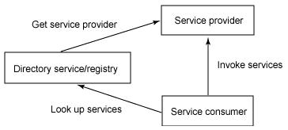
SOA

Slide 91
Architectural Styles:
C2

Slide 92
C2
Network of concurrent components hooked together by message routing devices
Motivation for C2 style
Support component-based software development
Support multi-lingual programming
Support distributed, heterogeneous environments
Support dynamic architectural changes

Slide 93
C2
Components and connectors both have a defined top and bottom.
The top of a component may be connected to the bottom of a single connector.
The bottom of a component may be connected to the top of a single connector.
no bound on the number of components or connectors that may be attached to a single connector.

Slide 94
C2
Components can only communicate via connectors; direct communication is disallowed.
Components communicate by passing messages; notifications travel down an architecture and requests up. Connectors are responsible for the routing and potential multi-cast of the messages.

Slide 95
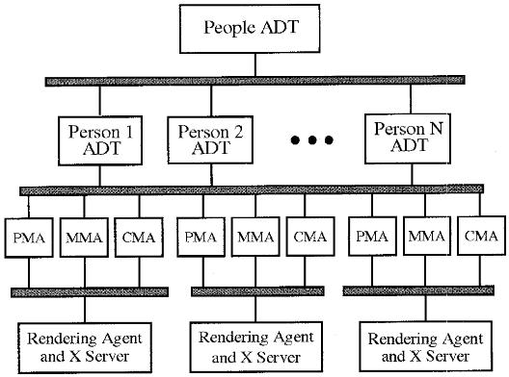
C2

Slide 96
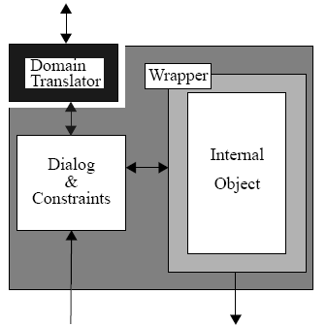
The internal architecture of a C2 component
Receives notifications and send requests
Mapping between component’s internal semantic domain and that of the connector above
Determines requests that can be received and notifications that can be sent
react to a notification
execute a request received
maintain some constraint
Receive
requests
Send notifications

Slide 97
The C2 architectural style
Connectors
Bind components together
Connected to components and other connectors
Routing and broadcast of messages
Message filtering

Slide 98
The C2 architectural style
Principles
Substrate independence
Message-based communication
Multi-threaded
Multiple programming languages
Heterogeneous environments
Implementation separate from architecture

